Slide 1
Understanding Trauma
Dr. Christina Downing, YMCA Youth & Family Services
Excel Beyond the Bell Symposium
March 15, 2016

Slide 2
Objectives
Our goals today are:
To be able to define trauma
To know the difference between traumatic experiences and being traumatized
To recognize signs of trauma
To know how we can make environments safe for youth by minimizing triggers
To be able to help youth calm down if traumatic reactions are triggered

Slide 3
What is trauma?
Merriam-Webster says…
1a. An injury (as a wound) to living tissue caused by an extrinsic agent.
1b. A disordered psychic or behavioral state resulting from severe mental or
emotional stress or physical injury
1c. An emotional upset
2. An agent, force, or mechanism that causes trauma

Slide 4
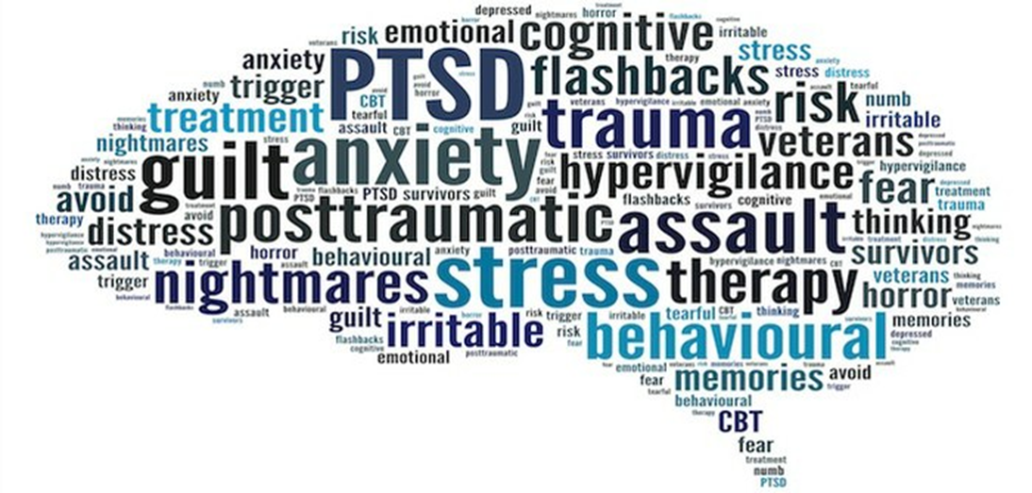
What most people think

Slide 5
Traumatic events
Physical abuse Assault Molestation Death of a loved one
Explosions Community violence Car accidents Drowning
Witnessing violence Terrorist attacks War Being arrested
Natural disasters Rape Divorce Bullying Medical procedures
Animal attacks Violent TV shows Emotional abuse Immigration
1st day of school Hearing about violence Being kidnapped
Notes:
We’re used to hearing about “traditional” traumatic events such as abuse, shootings, etc. But other events, such as medical procedures, television shows, and bullying can also be traumatic.
Two people can have the same experience and not have the same EXPERIENCE of that event. That’s part of what makes trauma such an individual concept.
Vicarious trauma: being traumatized HEARING about someone else’s trauma. A common experience of people in helping professions.

Slide 6
Clinical descriptions of trauma
Reactive attachment disorder
Disinhibited Social Engagement Disorder
Acute Stress Disorder
Post Traumatic Stress Disorder (PTSD)
Adjustment Disorder
Notes:
Reactive attachment: inhibited, emotionally withdrawn behavior toward adult caregivers, limited positive affect, unexplained irritibility/saddness/fearfulness during nonthreatening caregiver interactions, there is a history of inconsistent, insufficient care (neglect, abandonment, frequent changes in primary caregiver)
Disinhibited soc engagement: youth approaches and interacts with unfamiliar adults (being clingy with strangers, no initial hesitation with strangers, over shares details about self/family/friends, culturally accepted age appropriate social boundaries are regularly violated); development related to the same conditions assoc with reactive attachment disorder
Acute Stress: Similar symptoms as PTSD, but duration is much shorter (3 days to 1 month after exposure to the traumatic event)
PTSD: exposure to actual or threatened death, serious injury, or sexual violence, recurring involuntary & intrusive thoughts about the event, distressing dreams, dissociative reaction, persistent avoidance of stimuli assoc with the traumatic event (cognitive and environmental), negative changes in mood assoc with the traumatic event. DURATION IS MORE THAN 1 MONTH AND CAUSES SIGNIFICANT IMPAIRMENT IN FUNCTIONING. Child symptoms emphasize behavioral changes such as hypervigilence, exaggerated startle responses, negative emotional outbursts, etc
Adjustment: symptoms similar to the other disorders and onset is directly linked to a change and/or consequences of a change that negatively impact a child. EXAMPLES- parents separating and custodial parent moving with youth to a smaller home, parent being deported, sibling going to jail & sibling was a major source of emotional support. ONSET IS W/N 3 MO OF STRESSOR AND DON’T LAST MORE THAN 6 MO AFTER STRESSOR OR CONSEQUENCES OF STRESSOR HAVE ENDED.

Slide 7
Adverse Childhood Experiences (ACEs)
Adverse childhood experiences (ACEs) are stressful or traumatic events, including abuse and neglect. They may also include household dysfunction such as witnessing domestic violence or growing up with family members who have substance abuse disorders.
Reference: http://www.samhsa.gov/capt/practicing-effective-prevention/prevention-behavioral-health/adverse-childhood-experiences

Slide 8
The impact of ACEs
Multiple studies found correlations between ACEs and various problems later in life. These problems include:
Alcoholism Unintended pregnancy Illicit drug use Teen pregnancy
Liver disease STIs Chronic medical conditions Alcohol abuse
Depression Early initiation of smoking Early initiation of sexual activity
http://www.cdc.gov/violenceprevention/acestudy/findings.html

Slide 9
Take the ACE Quiz
Prior to your 18th birthday:
Did a parent or other adult in the household often or very often… Swear at you, insult you, put you down, or humiliate you? or Act in a way that made you afraid that you might be physically hurt?
Did a parent or other adult in the household often or very often… Push, grab, slap, or throw something at you? or Ever hit you so hard that you had marks or were injured?
Did an adult or person at least 5 years older than you ever… Touch or fondle you or have you touch their body in a sexual way? or Attempt or actually have oral, anal, or vaginal intercourse with you?
Reference: http://acestoohigh.com/got-your-ace-score/

Slide 10
ACE Quiz (part 2)
Did you often or very often feel that … No one in your family loved you or thought you were important or special? or Your family didn’t look out for each other, feel close to each other, or support each other?
Did you often or very often feel that … You didn’t have enough to eat, had to wear dirty clothes, and had no one to protect you? or Your parents were too drunk or high to take care of you or take you to the doctor if you needed it?
Were your parents ever separated or divorced?
Was your mother or stepmother: Often or very often pushed, grabbed, slapped, or had something thrown at her? or Sometimes, often, or very often kicked, bitten, hit with a fist, or hit with something hard? or Ever repeatedly hit over at least a few minutes or threatened with a gun or knife?
Reference: http://acestoohigh.com/got-your-ace-score/

Slide 11
ACE Quiz (part 3)
Did you live with anyone who was a problem drinker or alcoholic, or who used street drugs?
Was a household member depressed or mentally ill, or did a household member attempt suicide?
Did a household member go to prison?
Now add up your “Yes” answers: ___ This is your ACE Score
Reference: http://acestoohigh.com/got-your-ace-score/

Slide 12
Original findings
Research was initially collected between 1995-1997 from more than 17,000 people. (http://www.cdc.gov/violenceprevention/acestudy/prevalence.html)
# of Adverse Childhood Experiences (ACE Score) | Women | Men | Total
0 | 34.5 | 38.0 | 36.1
1 | 24.5 | 27.9 | 26.0
2 | 15.5 | 16.4 | 15.9
3 | 10.3 | 8.6 | 9.5
4 or more | 15.2 | 9.2 | 12.5
Notes:
So how did you do?
How do you feel about your score, knowing what you know now about ACEs?
If you had a high score, what do you think helped you get to where you are now as an adult?

Slide 13
Experiencing trauma ≠ Traumatized
Experiencing a traumatic event does not mean that a person is traumatized.
The descriptor traumatized describes a person who has experienced a traumatic event and subsequently experiences any number of negative responses directly related to the experience.
The ability to “bounce back” after a traumatic/negative life event is known as resilience.
Notes:
It’s important for adults to let the youth lead the process of exploring their understanding of an ACE. So instead of saying “Wow, you must really feel scared after seeing that fight outside the rec center yesterday.” The dialogue starts more like “I heard you saw the fight outside the rec center yesterday. What were you thinking when you saw it?”
Resilience is important because it gives us clues about how people can move forward in life after adverse life events. A youth’s ability to “bounce back” can counteract the negative impact of an ACE.

Slide 14
Building resilience
Make social connections with peers, family members and other trusted adults
Have a routine
Empowerment through helping others
Take a break (technology & social media vacations)
Self-care (aka “down time”, make time for fun)
http://www.apa.org/helpcenter/resilience.aspx

Slide 15
Building resilience
Work toward small goals and build from there
Nurture a positive self view (remember past success)
Keep things in perspective and have a hopeful outlook (reframing)
Look for opportunities for self discovery
Accept that change is part of life
http://www.apa.org/helpcenter/resilience.aspx

Slide 16
Knowing who’s traumatized
It’s likely that your work with youth won’t include a debriefing of any stress related mental health disorders.
You may not even be aware of past traumatic events that may manifest as a diagnosable disorder
But even if you don’t know of a diagnosis, you can still interact with youth in your setting in a way that is positive and supportive.

Slide 17
Escalation
When a youth is triggered, their emotional and behavioral responses increase in intensity. In many cases the increase is out of proportion to the precipitating event.
This increase may be signaled by:
Increased opposition to directives, pacing in the classroom/group space, pushing objects, clenching fists, yelling, lowered frustration tolerance, diminished eye contact, increased fidgeting, visible tensing of the body, etc.
Notes:
What is escalation? Escalation is a term that generally refers to an increase in agitated behaviors/verbalizations
Common precipitating events: being called on in class, peers snickering at an incorrect response, losing a privilege, losing a game, difficulty completing a challenging task

Slide 18
Escalation (con’t)
It’s important that those working with youth recognize the early signs of escalation so they can intervene and hopefully prevent an outburst.
As a person gets increasingly agitated they are less able to respond appropriately to those around them.
Essentially the person’s brain is “hijacked” by emotion which leads them to a fight, flight or freeze response.
Notes:
Our brains are very good at triggering responses before conscious thought can catch up.
We are all programmed to survive the situations around us. Our sympathetic and parasympathetic nervous systems prepare our bodies to react in whatever way will help us survive. It may not seem “logical” to an observer

Slide 19
Fight, Flight, Freeze
Fight: hitting, kicking, throwing objects, yelling, cursing, insults, arguing
Flight: running away, avoiding an certain staff, skipping activities/program days, frequent and/or extended trips to the bathroom or nurse
Freeze: physically not moving, verbally unresponsive, blank or “glassy” eyed stare, retreat postures
Notes:
In some cases a youth may literally be unable to hear or see certain aspects of the environment because their bodies are focused on the protective response in progress.

Slide 20
What can trigger trauma responses?
Being touched (gently or unexpectedly)
Smells present during the traumatizing event
Looking similar to an abuser (facial features, gender)
Being in an environment similar to the traumatizing event
Loud, chaotic settings
People yelling at, or around, the youth
Being embarrassed in front of a peers
Notes:
Smells are particularly potent triggers because the sense of smell has a direct connection to the limbic system (our emotion center). Think about a time you were somewhere and you smelled something that reminded you of a pleasant memory from your past.
Touch can be another trigger, especially if the trauma is abuse related. Even something as simple as a hug can be threatening.
Certain sounds can be triggers as well. DESCRIBE THE LITTLE ALBERT EXPERIMENT (WHITE RABBIT-SOUND CONNECTION)

Slide 21
When Trauma is Activated
With an emotionally activated person the mind and body respond to the environment as if they are in a threatening situation.
Though experiencing flashbacks is possible, the person may not be actively recalling atraumatic event or events.
It’s important that the adults around an activated youth be able to keep calm and be understanding during and after an episode of escalation.

Slide 22
De-escalation
Helping a youth who is activated
Keep a safe distance, clear the space or move with the youth to a quiet space
Keep your voice even and neutral, keep volume low if they are yelling
Help them focus on the present moment
Make requests short and direct, give options when possible
Describe your observations in terms of feelings and elicit youth confirmation
Call/signal for additional staff support if needed
Notes:
Keeping a safe distance will help the youth free to move as needed
Tone of voice should be calming, especially if the youth is yelling
When giving options, make sure they are options that you’re OK with (e.g. “would you like to talk in the hallway or walk and talk outside?”)
The present moment is what’s happening in that instant, if they’re yelling about something that just happened let them know you want to hear about it, but they have to calm down first
Describing: “You look pretty >insert feeling<, is that right? How can I help you feel better?

Slide 23
Creating a safe environment
Use calm tone of voice to communicate
Be flexible with visualization exercises or activities that require closed eyes
Be mindful of physical contact
Have a check-in system to get a pulse of the group’s mood
Make 1:1 connections with youth you are concerned about
Encourage supportive peer responses when a youth gives an incorrect response
Enlist the peer “leaders” whenever possible to help set a positive example
If working 1:1 with a youth, arrange seating in “safe” configuration if possible
Notes:
Calm voice: Clearly using a calm tone is an effective way to communicate. But with a traumatized youth calm voices may help them stay present in a safe situation. This is especially true if the trauma relates to yelling/arguing/humiliation
Visualization exercises can be good in a number of contexts, but for some youth closing their eyes can make them feel unsafe and increase the likelihood of intrusive thoughts/feelings. I like to offer the option to look at the floor or some other specific spot just in case it’s an issue.
As with visualization exercises, physical contact can activate a trauma response. Especially if contact is unexpected. Follow the youth’s lead (and professional standards) regarding physical contact.
Check in system: can be as simple as 1 or 2 questions or a feeling board that youth can report on. You may find that multiple youth are having a “bad” day which would be a signal to process an event or events that may have occurred in the community.

Slide 24
Trauma disclosure
What do you do when a youth discloses traumatic events to you?
Know your CPS reporting obligations and agency’s procedures
Empathic listening, open ended questions
Be ready for the youth to stop abruptly OR disengage after disclosure
You are NOT an investigator, avoid asking too many questions
Leave the door open for future communication
Make sure YOU have someone you can process the situation with (vicarious trauma)

Slide 25
My Contact Information
christina.downing@ymcadc.org
301-284-8586 (cell)

